Slide 1
ITA

Slide 2
Web Engineering: A Practitioner’s Approach
by Roger S. Pressman and David Lowe
copyright © 2009
Roger S. Pressman and David Lowe
For Education Use Only
May be reproduced ONLY for student use at the university level when used in conjunction with Web Engineering: A Practitioner's Approach.

Slide 3
Chapter 1
Web-Based Systems

Slide 4
The Web
An indispensable technology
In every aspect of modern living - buy products (e-commerce), meet people (online dating), understand the world (portals), acquire our news (online media), voice our opinions (blogs), entertain ourselves (everything from music downloads to online casinos), and go to school (online learning).
A transformative technology
Changes the way we do things
Changes the way we acquire and disseminate information
An evolving technology
Bottom line—high impact on everyone in the modern world

Slide 5
WebApps
The term Web application (WebApp) encompasses:
Everything from a simple Web page that might help a consumer to compute an automobile lease payment to a comprehensive website that provides complete travel services for business people and vacationers.
Category:
Complete websites
Specialized functionality within websites
Information-processing applications that reside on the Internet or on an Intranet or Extranet

Slide 6
WebApps
Means HTML, Java, XML, or any of the countless technologies that must be understood to build successful Web-based systems/applications (WebApps)
WebApps can be pivotal to the success of all businesses and organizations

Slide 7
Web-Based Systems
In the early days, the Web systems built using informality, urgency, intuition, and art
Informality leads to an easy work environment—one in which you can do your own thing.
Urgency leads to action and rapid decision making.
Intuition is an intangible quality that enables you to “feel” your way through complex situations.
Art leads to aesthetic form and function—to something that pleases those who encounter it.
Problem is—this approach can and often does lead to problems

Slide 8
Web-Based Systems
As WebApps become larger and more complex,
Informality remains, but some degree of requirements gathering and planning are necessary
Urgency remains, but it must be tempered by a recognition that decisions may have broad consequences
Intuition remains, but it must be augmented by proven management and technical patterns
Art remains, but it must be complemented with solid design
Bottom line—we must adapt the old-school approach to the realities of a Web 2.0 world….and now Web 3.0 world

Slide 9
WebApp Attributes
Data driven
Performance – Not to wait too long for serverside processing, for client-side formatting and display
Continuous evolution
Immediacy - exhibit a time-to-market
Network intensiveness - diverse community of clients on net
Concurrency - Large number of users may access at one time
Unpredictable load- No. of users of may vary from day to day.
Availability
Content sensitive- simple, yet meaningful for nontechnical user
Security
Aesthetics- appeal of a WebApp’s look and feel

Slide 10
WebApp Types
Informational- readonly content with simple navigation and links
Download - informational and download capability
Customizable – different for each different user
Interaction – chat room
User input – take input from user in form for automization
Transaction-oriented – automated based on user request
Service-oriented
Portals - providing website links having answers for customer
Database access
Data warehousing
(see http://digitalenterprise.org/models/models.html for examples)

Slide 11
Web Apps
Why Web Applications/Web based systems fail?
Because many built in an ad hoc manner
With little regard to the
Fundamental principles of problem analysis
Effective design
Solid testing
Change management

Slide 12
And What’s the Solution?
Web Engineering

Slide 13
Web Engineering
Goal is to build WebApps or Web based system that satisfy users’ needs and provide real benefit to their clients’ businesses or organizations.
i.e. To build industry-quality WebApps

Slide 14
Chapter 2: Web Engineering
Definition
An agile, yet disciplined framework for building industry-quality WebApps

Slide 15
Agile Approach
Business strategies and rules change rapidly
Management demands near-instantaneous responsiveness (even when such demands are completely unreasonable)
Stakeholders often don’t understand the consequences of the Web and keep changing their mind even as they demand rapid delivery
An agile approach helps to manage with this fluidity and uncertainty

Slide 16
Agile Approach
Able to appropriately respond to changes, Change is to
The software being built
The team members
New technology
Of all kinds that may have an impact on the product they build or the project that creates the product
Support for changes should be built-in everything we do in software
An agile team recognizes that software is developed by individuals working in teams and that the skills of these people, their ability to collaborate is at the core for the success of the project

Slide 17
What is an Agile Process?
Agile Web engineering combines a philosophy and a set of development guidelines. The philosophy encourages:
Customer satisfaction
Early incremental delivery of the WebApp
Small, highly motivated project teams
Informal methods
Minimal work products
Overall development simplicity
An agile process stresses delivery over analysis and design and also active and continuous communication between developers and customers.

Slide 18
What is a WebE Framework?
Framework
A set of activities that will always be performed for every Web Engineering project – though the nature of the activities might vary to suit the project
Each framework activity is composed of a set of actions
Actions encompass
Work tasks
Work products
Quality assurance points
Project milestones
A framework also has a set of “umbrella activities”

Slide 19
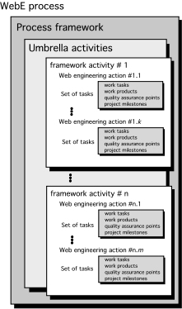
A Generic Framework

Slide 20
The WebE Framework: Activities
Communication
Planning
Modeling
Construction
Deployment

Slide 21
The WebE Framework: Activities
Communication. Involves heavy interaction and collaboration with the customer (and other stakeholders) and encompasses requirements gathering and other related activities.
Planning. Establishes an incremental plan for the WebE work.
Modeling. Encompasses the creation of models that assist the developer and the customer to better understand WebApp requirements and the design
Construction. Combines both the generation of HTML, XML, Java, and similar code with testing that is required to uncover errors in the code.
Deployment. Delivers a WebApp increment to the customer who evaluates it and provides feedback based on the evaluation.

Slide 22
Adapting the Framework
Adapt
to the problem
to the project
to the team
to the organizational culture
to adapt throughout the project as circumstances change!

Slide 23
Adapting the Framework
Adaptation leads to,
Overall flow of activities, actions, and tasks and the interdependencies among them
Degree to which work tasks are defined within each framework activity
Degree to which work products are identified and required
Manner in which quality assurance activities are applied
Manner in which project tracking and control activities are applied
Overall degree of detail and rigor with which the process is described
Degree to which customers and other stakeholders are involved with the project
Level of autonomy given to the software project team
Degree to which team organization and roles are prescribed

Slide 24
Underlying Agility Principles
Highest priority is to satisfy the customer through early and continuous delivery of valuable software.
Welcome changing requirements, even late in development. Agile processes harness continuous change for the customer's competitive advantage.
Deliver working software increments frequently, from as often as every few days to every few months, with a preference to the shorter timescales.

Slide 25
Underlying Agility Principles
Business people and developers must work together daily throughout the project.
Build projects around motivated people. Give them needed environment and support, and trust them to get the job done.
The most efficient and effective method of conveying information to and within a development team is face-to-face conversation.

Slide 26
Underlying Agility Principles
Working software is the primary measure of progress.
Agile processes promote sustainable development. The sponsors, developers, and users should be able to maintain a constant pace indefinitely.
Continuous attention to technical excellence and good design enhances agility.

Slide 27
Underlying Agility Principles
Simplicity—the art of maximizing the amount of work not done—is essential.
The best architectures, requirements, and designs emerge from self-organizing teams.
At regular intervals, the team reflects on how to become more effective, then tunes and adjusts its behavior accordingly.

Slide 28

Web Engineering = Software Engineering ?
Software engineering principles, concepts, and methods can be applied to Web development, but their application requires a somewhat different approach than their use during the development of conventional software based systems.
Software engineering is a layered technology

Slide 29
Software Engineering Layers
Quality: Foster a continuous process improvement culture
Process: The glue that holds the technology layers together
Work products (e.g., models and documents) are produced, milestones are established, quality is ensured, and change is properly managed
Methods: Provide the technical how-to’s
Communication, requirements analysis, design modeling, program construction, testing, and support.
Tools: Support for the process and the methods

Slide 30
Web Engineering
Web Engineering differed from Software Engineering…
WebE framework must be defined within a process that:
(1) embraces change,
(2) encourages the creativity and independence of development staff and strong interaction with WebApp stakeholders,
(3) builds systems using small development teams, and
(4) emphasizes incremental development using short development cycles

Slide 31
WebE Methods
Encompasses a set of technical tasks that enable a Web engineer to understand, characterize, and then build a high-quality WebApp
Communication methods
Requirements analysis methods
Design methods
Construction methods
Testing methods

Slide 32
WebE Methods
Communication methods
Define the approach used to facilitate communication between Web engineers and all other WebApp stakeholders (e.g., end users, business clients, problem domain experts, content designers, team leaders, project managers)
Communication techniques are important during requirements gathering and whenever a WebApp increment is to be evaluated
Requirements analysis methods
Provides understanding the deliverable content of a WebApp, functions for the end user, and the navigation modes of interaction for each class of user

Slide 33
WebE Methods
Design methods
Design techniques for WebApp content, application and information architecture, interface design, and navigation structure
Construction methods
Set of languages, tools, and related technology to create WebApp
Testing methods
Testing component-level and architectural issues
Navigation testing
Usability testing
Security testing
Configuration testing

Slide 34
WebE Methods
Other than these are
Project management techniques
Estimation
Scheduling
Risk analysis
Software configuration management techniques
Review techniques

Slide 35
Industry-Quality WebApps
Characteristics
Take the time to understand business needs and product objectives, even if the details of the WebApp are vague.
Describe how users will interact with the WebApp using a scenario-based approach.
Always develop a project plan, even if it’s very brief.
Spend some time modeling what it is that you’re going to build.
Review the models for consistency and quality.
Use tools and technology that enable you to construct the system with as many reusable components as possible.
Don’t reinvent when you can reuse.
Don’t rely on early users to debug the WebApp—design and use comprehensive tests before releasing the system.

Slide 36
Industry-Quality WebApps
Characteristics :
Take the time to understand business needs and product objectives, even if the details of the WebApp are vague
Many WebApp developers erroneously believe that vague requirements (which are quite common) relieve them from the need to be sure that the system they are about to engineer has a legitimate business purpose
The end result is (too often) good technical work that results in the wrong system being built for the wrong reasons and for the wrong audience
If stakeholders cannot describe a business need for the WebApp, proceed with extreme caution
If stakeholders struggle to identify a set of clear objectives for the product (WebApp), do not proceed until they can

Slide 37
Industry-Quality WebApps
Characteristics :
2. Describe how users will interact with the WebApp using a scenario based approach
Stakeholders should be convinced to develop scenarios (Chapters 4, 5, and 7) that reflect how various users will interact with the WebApp
These scenarios can then be used:
(1) for project planning and tracking,
(2) to guide analysis and design modeling, and
(3) as important input for the design of tests

Slide 38
Industry-Quality WebApps
Characteristics :
3. Develop a project plan, even if it’s very brief
Base the plan (Chapter 5) on a process framework that is acceptable to all stakeholders
Because project time lines are very short, use a “fine” granularity for schedule-project should be scheduled and tracked on a daily basis
Many WebApp developers erroneously believe that vague requirements (quite common) relieve them from the need to be sure that the system they are about to engineer has a legitimate business purpose
The end result is (too often) good technical work that results in the wrong system being built for the wrong reasons and for the wrong audience
If stakeholders cannot describe a business need for the WebApp, proceed with extreme caution

Slide 39
Industry-Quality WebApps
Characteristics :
4. Spend some time modeling what it is that you’re going to build
Generally, comprehensive analysis and design documentation is not developed as a part of Web engineering work
However, well-targeted graphical models (Chapters 6 through 12) can and do illuminate important engineering issues

Slide 40
Industry-Quality WebApps
Characteristics :
5. Review the models for consistency and quality
Pair walkthroughs and other types of reviews (Chapter 5) should be conducted throughout a WebE project
The time spent on reviews pays important dividends because it often eliminates rework and results in a high-quality WebApp—thereby increasing customer satisfaction

Slide 41
Industry-Quality WebApps
Characteristics :
6. Use tools and technology that enable you to construct the system with as many reusable components as possible
A wide array of WebApp tools is available for virtually every aspect of the WebApp construction (Chapter 14)
Many of these tools enable a Web engineer to build significant portions of the application using reusable components

Slide 42
Industry-Quality WebApps
Characteristics :
7. Don’t reinvent when you can reuse
A wide range of design patterns have been developed for WebApps
These patterns allow a WebE team to develop architectural, navigation, and component-level details quickly using proven templates (See Chapter 13 for a detailed discussion)

Slide 43
Industry-Quality WebApps
Characteristics :
8. Don’t rely on early users to debug the WebApp—design comprehensive tests and execute them before releasing the system
Users of a WebApp will often give it one chance. If it fails to perform, they move elsewhere—never to return
It is for this reason that “test first, then deploy” should be an overriding philosophy, even if deadlines must be stretched
See Chapter 15 for details

Slide 44
Chapter 3
The WebE Process

Slide 45
Chapter 3: The WebE Process
The process must be agile and adaptable, but it must also be incremental
Why incremental?
Requirements evolve over time
Changes will occur frequently (and always at inconvenient times
Time lines are short
Incremental delivery allows you to manage this change!

Slide 46
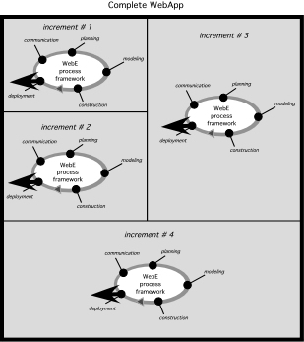
Incremental Delivery
Repeat the development cycle for each increment!
-Communication
-Planning
-Modeling
-Construction
-Deployment

Slide 47
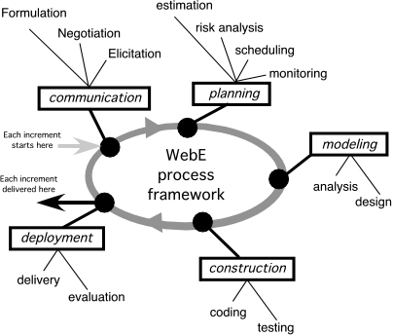
WebE Process Activities & Actions
2
1
3
5
4

Slide 48
WebE Process: Communication
Communication → Planning → Modeling → Construction → Deployment
Communication is the activity that establishes the “destination” for a WebApp project
For a simple destination, there are a relatively small number of informal actions and tasks required to be sure you know where you’re going
If the destination is more difficult to describe, you’ll need to refine the communication activity with more care

Slide 49
WebE Process: Communication
Objectives:
Identify business stakeholders
Identify user categories
Formulate the business context
Define key business goals and objectives for the WebApp
Identify the problem to Solve, Input/Output for the End User, functionality required to manipulate data
Define informational and applicative goals for classes of content are to be provided to end users, and how dynamic is the content; that is, how often does it change…
Gather requirements about content, interaction metaphor, Computational functions, navigation schema
Develop usage scenarios

Slide 50
WebE Process: Planning
Communication → Planning → Modeling → Construction → Deployment
Activity requiring the following to model, construct, and deploy the increment
Estimation of effort and time required to deploy the increment
In terms of person-days and time (calendar days)
Resources (people, hardware, software) required to do the work
Assessment of risks associated with the delivery of the increment high-probability, high-impact risks to be mitigated
Development schedule for the increment for tasks to be allocated along the time line and to establish intermediate milestones
Establishment of
Work products (written scenarios, sketches, models, documents) to be produced as a consequence of each framework activity
Quality assurance approach

Slide 51
WebE Process: Modeling
Communication → Planning → Modeling → Construction → Deployment
An activity that creates one or more conceptual representations of some aspect of the WebApp to be built
A conceptual representation-one or more of the following forms:
Written documents
Sketches
Schematic diagrams
Graphical models
Written scenarios
Paper or executable prototypes
Executable code
Two Web engineering actions occur during modeling:
Analysis
Design

Slide 52
WebE Process: Analysis Modeling
This model focuses on WebApp content, modes of interaction (including navigation), functionality, and the technical configuration of the WebApp
From the communication,
If information exists and is complete, → no need for analysis modeling for the increment
If the information is incomplete or implies a degree of complexity → demands further examination, proceed to the analysis modeling tasks

Slide 53
WebE Process: Analysis Modeling
The following tasks are to be done during an analysis model:
Represent WebApp content, decide static (do not change based on user type/input) and dynamic (generated based on user type/input)
Identify content form and style of each content class and relationships among them
Refine and extend user scenarios for input, steps and to check consistency and of enough detail
Create an interaction model for complex scenarios showing the relationship between user and each task and user actions transition from one state to another
Refine interface requirements for menus, layout, navigation
Identify functions and user input for function
Define constraints and performance requirements and privacy policy
Identify database requirements, content interface for the database

Slide 54
WebE Process: Design Modeling
The goal is to produce a model or representation
If the increment is well understood and very easy to construct, the only design model might be a simple sketch
If, on the other hand, the increment is more complex, a more detailed design model may be created

Slide 55
WebE Process: Design Modeling
The model can consider some/all aspects of WebApp design:
Interface design
Aesthetic design
Content design
Navigation design
Architecture design
Component design

Slide 56
WebE Process: Design Modeling
The model can consider some/all aspects of WebApp design:
Interface design
Describes the structure and organization of the user interface
Includes a representation of screen layout, a definition of the modes of interaction, and a description of navigation mechanisms
Aesthetic design
Aka graphic design, describes the “look and feel” of the WebApp
Includes color schemes, geometric layout, text size, font and placement, the use of graphics, and related aesthetic decisions
Content design
Defines the layout, structure, and outline for all content
Establishes the relationships among content objects

Slide 57
WebE Process: Design Modeling
The model can consider some/all aspects of WebApp design:
Navigation design
Represents the navigational flow among content objects and functions
Architecture design
Identifies the overall hypermedia structure for the WebApp
Component design
Develops the detailed processing logic required to implement functional components that implement a complete WebApp function

Slide 58
WebE Process: Design Modeling
The following to consider to develop a design model:
For each usage scenario, design the
Interaction tasks and subtasks to be represented as part of the interface
Required interface control mechanisms (e.g., links, buttons, menus)
Control mechanisms positions on a Web page
Design the aesthetic for the WebApp user categories by considering consistent
Page layout , color and form, navigation mechanisms positions and representation, all logos, graphics, images, and backgrounds implemented
Design the content/databases and data structures required to implement functionality or to display content
Design appropriate security and privacy mechanisms

Slide 59
WebE Process: Construction
Communication → Planning → Modeling → Construction → Deployment
As construction proceeds, you can perform two WebE actions:
Code generation
Testing
The following tasks help you plan the code generation action:
Build and/or acquire all content, and integrate the content into the WebApp architecture
Select the appropriate tool set for the generation of HTML code
Implement each page layout, function, form, and navigation capability
Implement all forms, scripts, and database interfaces and computation functions for the client/server side
Address configuration issues of browsers, plug-ins, and operating system environments for both the client/server sides

Slide 60
WebE Process: Construction
Once the WebApp has been constructed, it must be tested
Testing begins with a relatively narrow focus and then continues to exercise a broader view of the WebApp
The following tasks to plan the testing action :
Test all WebApp components (content and function)
Test navigation

Slide 61
WebE Process: Deploy
Communication → Planning → Modeling → Construction → Deployment
The following tasks are considered to deploy the WebApp increment:
Deliver the WebApp increment to a server at a predefined domain
Establish an online feedback mechanism for end users
Evaluate end-user interaction, assess lessons learned and consider all end-user feedback and make modifications to the WebApp increment as required

Slide 62
Ch.7 Analysis Modeling of WebApps
Modeling Language (ML)
Incorporates a set of notations, terms, and/or symbols, as well as the rules for establishing associations between them
Often has a formally structured representation as well as a set of graphical elements
Some MLs are general purpose (e.g., UML) and others are more specific (e.g., WebML)

Slide 63
Ch.7 Analysis Modeling of WebApps
Many software tools exist for the construction of WebApps, relatively few have been developed specifically for analysis
Four categories of tools can be used for analysis:
UML tools
Prototyping tools
Issue tracking tools
Content management tools

Slide 64
Ch.7 Analysis Modeling of WebApps
Unified Modeling Language (UML) tools
Used to create analysis models
Widely used in the software engineering community
Prototyping tools
Virtually any WebApp construction tool (e.g., Adobe GoLive) can be used to create an operational prototype
Allow fast layout, integration of content, and the development of rough aesthetics, all appropriate for the creation of a quick prototype
Issue tracking tools
Used to record and track the resolution of issues that arise out of interpretation of the emerging analysis models
Content management tools
Used to model the nature and structure of content objects of the WebApp

Slide 65
Case Study
You’ve been approached by CPI Corporation, a company that builds, markets, sells, and monitors security systems for homes and small businesses. CPI has no Web presence and wants to roll out a “significant” website that will coincide with the introduction of a new line of security sensors and a set of radically new Web-based services. They want your help in the development of the WebApp, which is called SafeHomeAssured.com, and at the same time for you to assist them as they create new Web services that will increase their market share.
CPI has engineered a compact, wireless sensor controller that will become the core element in a new line of commercial and residential security systems that it intends to call SafeHome.

Slide 66
Case Study
The features (content and function) to be implemented:
• Information about CPI and its products and people
• Specifications for all security hardware components, including pictures, technical descriptions, installation instructions, pricing, and other pertinent information
• Security system design assistance that enables a customer to specify a living or business space (e.g., rooms, doors, windows) and then get semi automated layout assistance for a security system
• e-Commerce capability that enables a customer to order security hardware and monitoring services
This capability will be coupled to backroom systems that support a customer purchase

Slide 67
Case Study
The following features (content and function) will be implemented:
• Customer monitoring via the Internet to enable a homeowner or business person to use video to monitor a space in real time
• Customer account access capability
• Customer service access capability including specialized in-house functionality
• Technical service staff access capability including specialized in-house functionality
In addition, CPI wants to abandon a brick-and-mortar sales strategy (i.e., salespeople, store fronts) and move toward a twenty-first century paradigm. The company wants to sell exclusively via the Web.

Slide 68
UML
Allows the “modeling”of actors
But in UML an actor strictly represents the idealization of a particular interaction with the system—rather than a user
The same user may participate in different interactions (and therefore be represented as different actors), but that user will carry his or her context across these roles
It is important to model the user context and not just the individual interactions
To achieve these, both the different users (using the «user» actors) and the different types of interactions in which those users participate (using the «interaction» actors)

Slide 69
UML-Case Study Actors
For SafeHomeAssured.com there are three main types of users, who can carry out four different types of interactions:
(1) Guests
Can browse the public information on products and download specs, as well as purchase products (but the system won’t remember their preferences)
(2) Registered users
Have access to the same functionality as guests, but the system will remember their preferences as well as allow them to purchase on an account
(3) Registered homeowners
Can browse information and buy products, but can also have their system monitored online
For each «user» actor → need to understand the nature of the user category—its context, needs, and behaviours

Slide 70
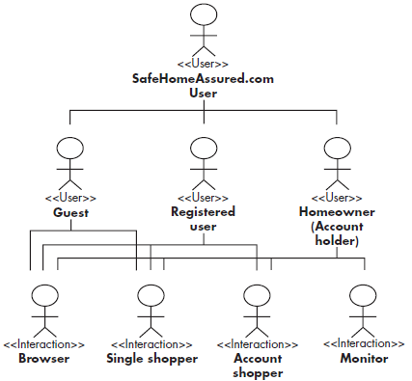
UML-Actors

Slide 71
UML-Conversation
The vast majority of WebApps enable a “conversation” between an end user and application functionality, content, and behavior
This conversation can be described using an interaction model that can be composed of one or more of the following elements: (1) use cases, (2) sequence diagrams, (3) state diagrams,and/or (4) user interface prototypes
In addition to these representations, the interaction is also represented within the context of the navigation model → “Relationship-Navigation Analysis”

Slide 72
Use Cases
The dominant element of the interaction model for WebApps
Not uncommon to describe 100 or more use cases when large, complex WebApps are analyzed, designed, and constructed
However, a relatively small percentage of the use cases describes the major interactions between end-user categories (actors) and the system
Other use cases refine the interactions, providing the analysis detail necessary to guide the design and construction

Slide 73
Use Cases
In many instances, a set of use cases is sufficient to describe the interaction at an analysis level
However, when the interaction sequence is complex and involves multiple analysis classes or many tasks, it is sometimes worthwhile to depict it using a more rigorous diagrammatic form

Slide 74
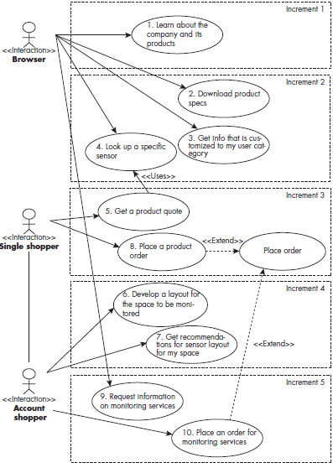
UseCase Diagram

Slide 75
Sequence Diagram
Shorthand representation of the manner in which user actions (the dynamic elements of a system defined by use cases) collaborate with analysis classes (the structural elements of a system)
Since analysis classes are extracted from use case descriptions, there is a need to ensure that traceability exists between the classes that have been defined and the use cases that describe system interaction
The merging of dynamic and structural elements of the [analysis] model is the key link in the traceability of the model and should be taken very seriously

Slide 76
Sequence Diagram
The vertical axis of the diagram
Depicts actions that are defined within the use case
The horizontal axis
Identifies the analysis classes that are used as the use case proceeds
For example:
A user logs in to the WebApp, navigates the relevant options, and selects a camera
The video from that camera is then displayed
The movement across and down the sequence diagram ties each analysis class to use case actions
If a use case action is missing from the diagram, you should reevaluate the description of analysis classes to determine if one or more classes are missing

Slide 77
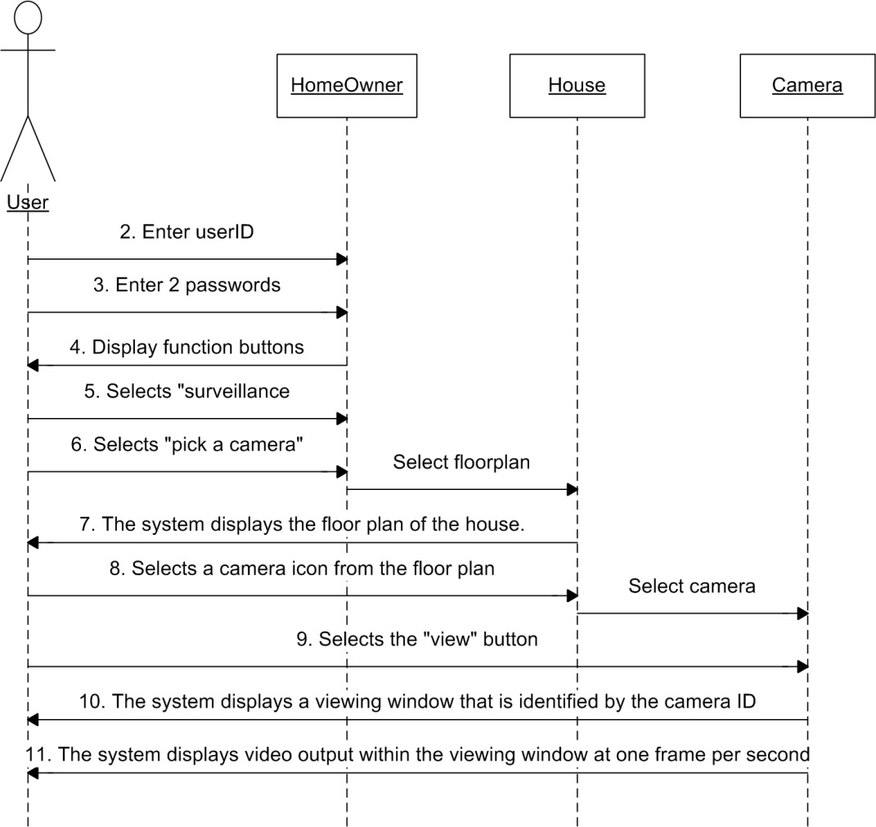
Sequence Diagram
For the Access camera surveillance via the Internet use case
Sequence diagrams can be created for each use case and the analysis classes defined for the use case

Slide 78
Present no
2 3 6 7 8 9 10
11 12 13 16 18 19 20
22 28 29 30
31 32 34 37 38
45 47 49 55
41 42 43 24 39 51 54 14 23 44 52 46 21 48 36 15

Slide 79
State Diagram
Provides another representation of the dynamic behavior of the WebApp as an interaction occurs
Like most modeling representations used in Web engineering, the state diagram can be represented at different levels of abstraction
State diagrams are most useful when a user interaction triggers a change in the state of the WebApp—and hence changes the way in which it might react to a user

Slide 80
State Diagram
A change of state occurs when the user observes a new mode of behavior for the WebApp
For example:
When a user who is browsing product descriptions requests a product quote, the request triggers a change of state from a product overview state to a product quotation state
The WebApp look and feel observed by the user may also change as a consequence

Slide 81
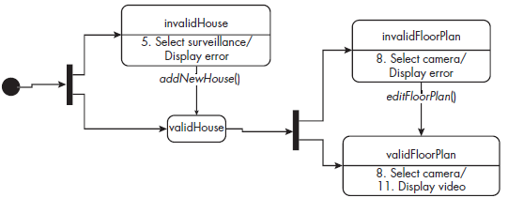
State Diagram
Often these changes of state will relate to interconnections between different use cases
For example, the Access camera surveillance via the Internet use case involves selecting a camera from a floor plan—but this is only possible if that user has previously configured (or had SafeHomeAssured.com configure) a floor plan

Slide 82
Use Case+Sequence Dia+State Dia?
Needed all three to Fully Describe the Interaction Model?
Because use cases, sequence diagrams, and state diagrams all present related information, it is reasonable to ask why all three are necessary. But, in some cases, they are not.
Use cases
May be sufficient in some situations, particularly if you have documented the exceptions thoroughly
However, use cases provide a rather one dimensional view of the interaction
Sequence diagrams
Present a second dimension that is more procedural (dynamic) in nature
State diagrams
Provide a third dimension that is more behavioral and contains information about potential navigation pathways that is not provided by use cases or the sequence diagrams

Slide 83
Use Case+Sequence Dia+State Dia?
When all three dimensions are used, omissions or inconsistencies that might escape discovery in one dimension become obvious when a second (or third) dimension is examined
It is for this reason that large complex WebApps can benefit from an interaction model that encompasses all three representations

Slide 84
Use Case+Sequence Dia+State Dia?
Key factors affecting whether or not use cases, sequence diagrams, and state diagrams are all necessary include the complexity of the overall increment, the consequences of an error for users

Slide 85
WebApp design
A combination of art and engineering
To be effective, a good design must accommodate each of the requirements established by stakeholders during the communication activity
But it must also accommodate the inevitable changes to requirements that will occur throughout the design and into construction and delivery

Slide 86
WebApp design
Design begins by focusing on the way in which a user will interact with an application and then moves to consider the functions and information content that will be required to meet stakeholders’ needs
It then proceeds to physical design, in which the logical elements are mapped into a representation that can be implemented as part of the WebApp
The primary output of the design activity is a design model that encompasses interface descriptions, aesthetics, content, navigation, architecture, and component-level design issues

Slide 87
WebApp design
Generic WebApp design goals:
simplicity, consistency, identity, robustness, navigability, visual appeal, and compatibility.
A variety of quality frameworks can be applied to WebApp design
A user-centric quality model provides a solid indication of the degree to which end users like the technology that the WebApp delivers
WebApp designers can apply a Design IQ Checklist that serves to assess the importance of various quality criteria and the degree to which the WebE team has met each of the criteria

Slide 88
WebApp design
The design process is an agile, iterative collection of design actions that are applied to each WebApp increment as it is created
A design pyramid can be used to describe a set of design actions that are performed (with varying degrees of emphasis) for each WebApp increment
The design actions include interface design, aesthetic design, content design, navigation design, functional design, architecture design, and component design
Each of the design actions represents a challenge for the WebE team

Slide 89
Relation-Navigation Analysis
Relationship-navigation analysis (RNA) provides a series of analysis steps that strive to identify relationships among the elements uncovered as part of the creation of the analysis model
The RNA approach is organized into five steps:
Stakeholder analysis. Identifies the various user categories, and establishes an appropriate stakeholder hierarchy
Element analysis. Identifies the content objects and functional elements that are of interest to end users
Relationship analysis. Describes the relationships that exist among the WebApp elements
Navigation analysis. Examines how users might access individual elements or groups of elements
Evaluation analysis. Considers pragmatic issues (e.g., cost-benefit) associated with implementing the relationships defined earlier

Slide 90
INTRODUCTION
Jakob Nielsen [Nie00] states: “There are essentially two basic approaches to design: the artistic ideal of expressing yourself and the engineering ideal of solving a problem for a customer.”
Even today, some proponents of agile software development use WebApps as poster children for the development of applications based on “limited design.”
However --
When content and function are complex
when the size of the WebApp encompasses hundreds of content objects, functions, and analysis classes
when multiple people become involved in the design; and
when the success of the WebApp will have a direct impact on the success of the business,
design cannot and should not be taken lightly.

Slide 91
WebApp Design
The design model encompasses content, aesthetics, architecture, interface, navigation, and component-level design issues.
The design model provides sufficient information for the WebE team to construct the final WebApp
alternative solutions are considered, and the degree to which the current design model will lead to an effective implementation is also assessed

Slide 92
Design Goals - I
Simplicity. Although it may seem old-fashioned, the aphorism “all things in moderation” applies to WebApps. Rather than feature-bloat, it is better to strive for moderation and simplicity.
Consistency.
Content should be constructed consistently
Graphic design (aesthetics) should present a consistent look
Architectural design should establish templates that lead to a consistent hypermedia navigation
Navigation mechanisms should be used consistently
Identity. The aesthetic, interface, and navigational design of a WebApp must be consistent with the application domain for which it is to be built.

Slide 93
Design Goals - II
Robustness. The user expects robust content and functions that are relevant to the user’s needs.
Navigability. users should be able to understand how to move about the WebApp without having to search for navigation links or instructions.
Visual appeal. design characteristics (e.g., the look and feel of content, interface layout, color coordination, the balance of text, graphics and other media, and navigation mechanisms) contribute to visual appeal.
Compatibility. Most WebApps will be used in a variety of environments (e.g., different hardware, Internet connection types, operating systems, and browsers) and must be designed to be compatible with each

Slide 94
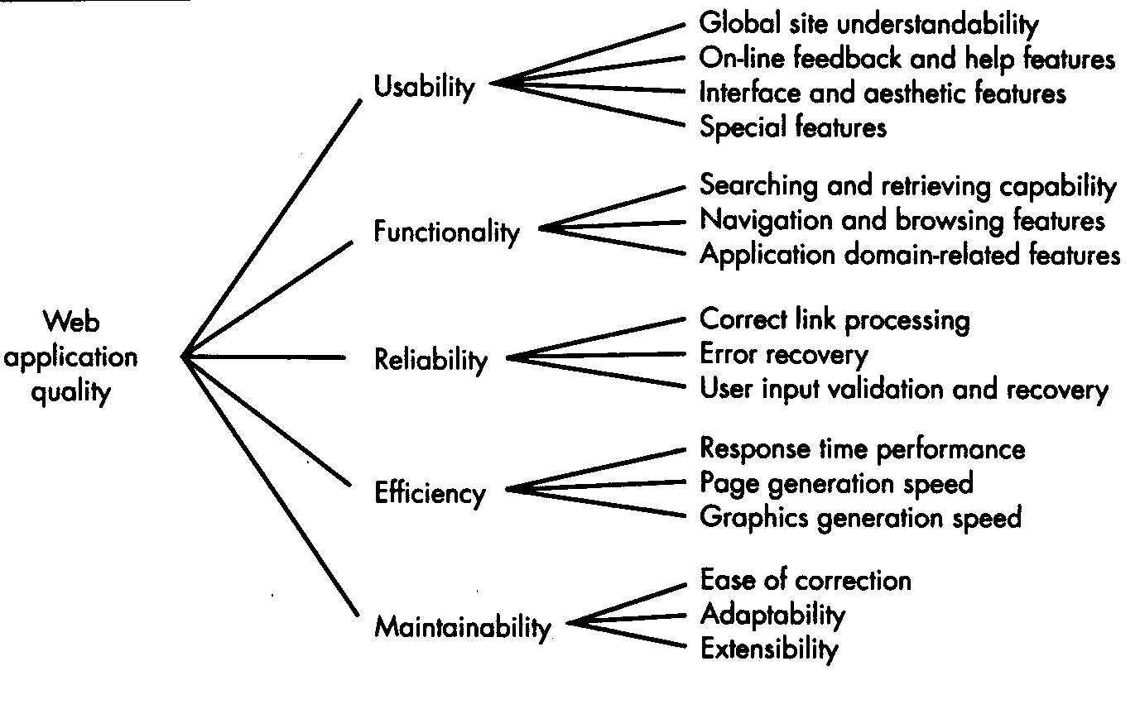
Design & WebApp Quality

Slide 95
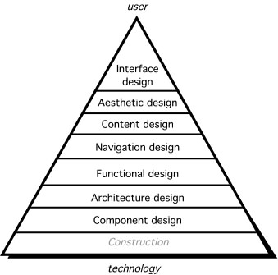
Design Actions

Slide 96
Conceptual Architecture
Provides an overall structure for the WebApp design
Affects all later increments – so important for it to developed in the context of the full set of likely increments
Represents the major functional and information components for the WebApp and describes how these will fit together
Depends on the nature of the WebApp, but in every case, it should ensure a sound integration between the WebApp information and the WebApp functionality.

Slide 97
Developing the architecture-I
How do we achieve an effective balance between information and functionality in the conceptual architecture?
A good place to start is with workflows or functional scenarios (which are an expression of the system functionality) and information flows
As a simple example, consider the following set of key functionalities for SafeHomeAssured.com
Provide product quotation
Process security system order
Process user data
Create user profile
Draw user space layout
Recommend security system for layout
Process monitoring order
Get and display account info
Get and display monitoring info
Customer service functions (to be defined later)
Tech support functions (to be defined later)

Slide 98
Developing the architecture-II
From these key functionalities we can identify the following partial list of functional subsystems:
UserManagement. Manages all user functions, including user registration, authentication and profiling, user-specific content, and interface adaptation and customization.
ProductManagement. Handles all product information, including pricing models and content management.
OrderHandling. Supports the management of customers’ orders.
AccountAdministration. Manages customers’ accounts, including invoicing and payment.
SecuritySystemSupport. Manages users’ space layout models and recommends security layouts.
SecuritySystemMonitoring. Monitors customers’ security systems and handles security events.
And, of course, there are overall management subsystems:
ClientInterface. Provides the interface between users and the other subsystems, as required to satisfy users needs.
SystemMaintenance. Provides maintenance functionality, such as database cleaning.

Slide 99
Architecture

Slide 100
Chapter 9 Interaction Design
Design an interface to answer three generic questions:
Where am I? The interface should (1) provide an indication of the WebApp that has been accessed and (2) inform users of their location in the content hierarchy.
What can I do now? The interface should always help users understand their current options—what functions are available, what links are live, what content is relevant?
Where have I been, where am I going? The interface must facilitate navigation. Hence, it must provide a “map” (implemented in a way that is easy to understand) of where users have been and what paths they may take to move elsewhere within the WebApp.

Slide 101
Design Principles (Tognozzi) - I
Anticipation. Designed so that it anticipates the user’s next move.
Communication. The interface should communicate the status of any activity initiated by the user.
Consistency. The use of navigation controls, menus, icons, and aesthetics (e.g., color, shape, layout) should be consistent throughout the WebApp.
Controlled autonomy. The interface should facilitate user movement throughout the WebApp, but it should do so in a manner that enforces navigation conventions that have been established for the application.
Efficiency. The design of the WebApp and its interface should optimize the user’s work efficiency, not the efficiency of the Web engineer who designs and builds it or the client-server environment that executes it.
Flexibility. The interface should be flexible enough to enable some users to accomplish tasks directly and others to explore the WebApp in a somewhat random fashion.
Focus. The WebApp interface (and the content it presents) should stay focused on the user task(s) at hand.

Slide 102
Design Principles (Tognozzi) - II
Fitt’s law. “The time to acquire a target is a function of the distance to and size of the target”
User Interface Objects. A vast library of reusable human interface objects (and patterns) has been developed for WebApps.
Latency reduction. Rather than making the user wait for some internal operation to complete (e.g., downloading a complex graphical image), the WebApp should use multitasking in a way that lets the user proceed with work as if the operation has been completed.
Learnability. A WebApp interface should be designed to minimize learning time and, once learned, to minimize relearning required when the WebApp is revisited.
Metaphors. An interface that uses an interaction metaphor is easier to learn and easier to use, as long as the metaphor is appropriate for the application and the user.

Slide 103
Design Principles (Tognozzi) - III
Maintain work product integrity. A work product (e.g., a form completed by the user, a user-specified list) must be automatically saved so that it will not be lost if an error occurs.
Readability. All information presented through the interface should be readable by young and old.
Track state. When appropriate, the state of user interactions should be tracked and stored so that users can log off and return later to pick up where they left off.
Visible navigation. A well-designed WebApp interface provides “the illusion that users are in the same place, with the work brought to them”

Slide 104
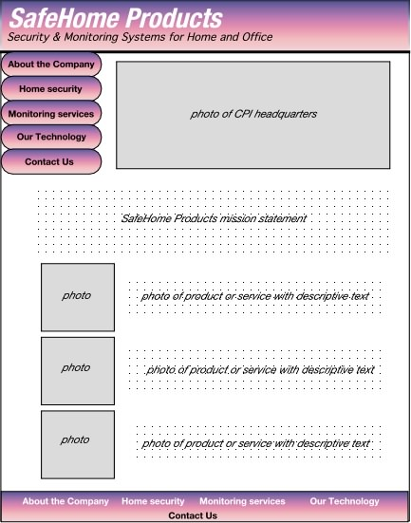
Preliminary Page Layout

Slide 105
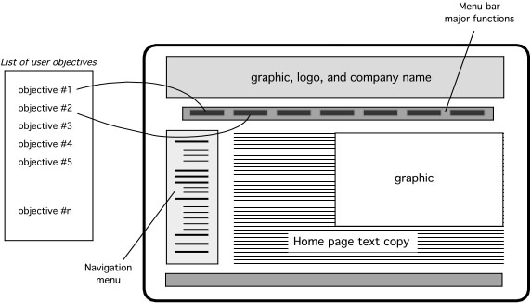
Interface Design Workflow - I
Review user characteristics and categories, user tasks, use cases, and related information contained in the analysis model and refine as required.
Develop a rough design prototype of the WebApp interface layout.
Map user objectives into specific interface actions.

Slide 106
Interface Design Workflow - II
Define a set of user tasks that are associated with each action.
Develop screen images for each interface action.
Refine interface layout and screen images using input from aesthetic design.
Identify user interface objects that are required to implement the interface.
Develop a procedural representation of the user’s interaction with the interface.
Develop a behavioral representation of the interface.
Describe the interface layout for each state.
Pair walkthroughs (Chapter 5) should be conducted throughout all these design tasks and should focus on usability.

Slide 107
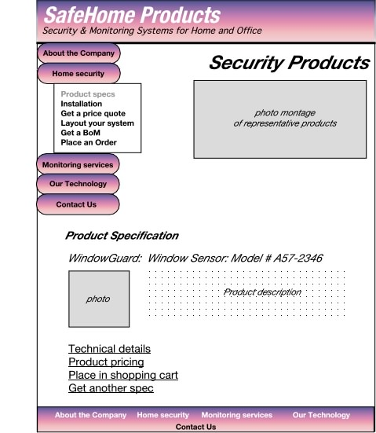
Elaborate the design

Slide 108
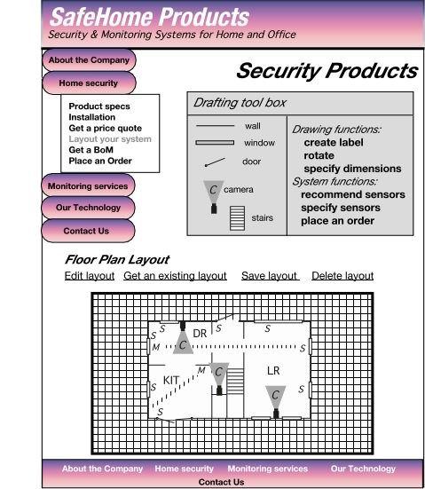
Elaborate the Design

Slide 109
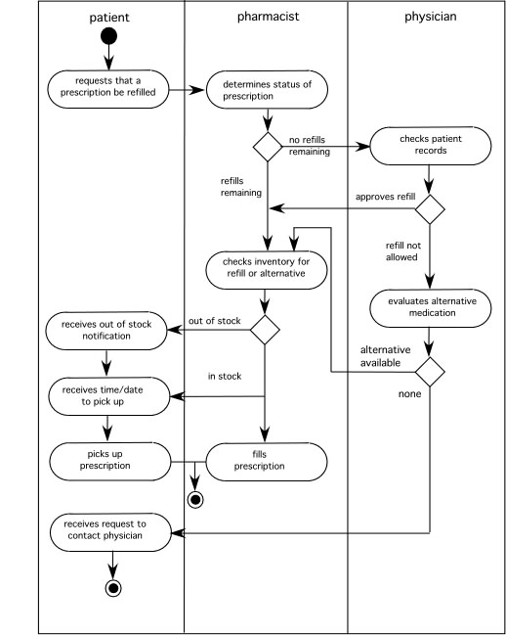
Different Users in Different Roles
The swimlane diagram:
Captures workflows and shows interactions between different users

Slide 110
Translating Actions and Objects
From the use case on pp. 213 - 214
Accesses the SafeHome system
Enters an ID and Password to allow remote access
Displays FloorPlan and SensorLocations
Displays VideoCameraLocations on floor plan
Selects VideoCamera for viewing
Views VideoImages (four frames per second)
Pans or zooms the VideoCamera
Based on these actions and objects we create a design layout -->

Slide 111
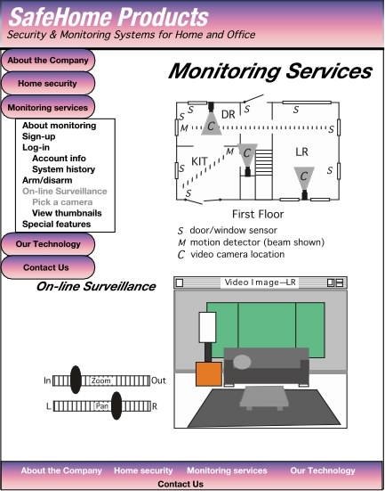
Design Layout

Slide 112
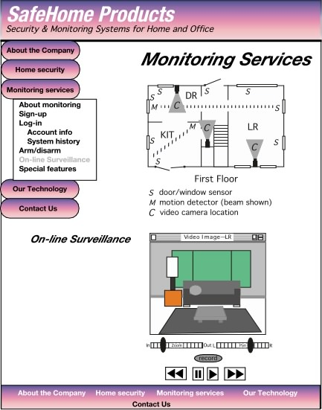
Revising the Layout

Slide 113
Aesthetic Design - I
Don’t be afraid of white space.
Emphasize content.
Organize layout elements from top-left to bottom-right.
Don’t extend your real estate with the scrolling bar.
Consider resolution and browser window size when designing the layout.
Design the layout for freedom of navigation.
Don’t assume that the layout will be consistent across different display devices and browsers.
If you use photos, make them small format with the option to enlarge.
If you want a cohesive layout, look, and feel across all WebApp pages, use a cascading style sheet (CSS).

Slide 114
Other Design Issues
Response time
“Help” facilities
Error handling
Accessibility
Internationalization

Slide 115
Managing Risk
Many problems can arise during a project
Risk management focuses on understanding and managing these problems
Identify the risk; Assess its probability of occurrence; Estimate its impact; Establish a contingency plan
Considers risk at two different levels of granularity
(1) the impact of risk on the entire WebApp project, and
(2) the impact of risk on the current WebApp increment
Typical risks:
Is the time timeframe defined and reasonable?
Will the increments provide ongoing value for end users?
How will requests for change impact delivery schedules?
Is the available technology appropriate for the job?
Does the team have the right mix of skills to build this increment?

Slide 116
Identifying Risks
Address the fundamental question: “What can go wrong?”
Each team member is asked to make a list of risks
People risks
Potential problems that can be directly traced to some human action or failing
Product risks
Potential problems associated with WebApp content, functions, constraints, or performance
Process risks
Problems that are tied to the framework actions and tasks that have been chosen by the team

Slide 117
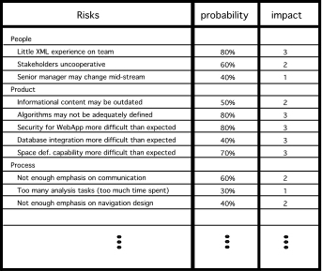
Risk Analysis

Slide 118
Developing a Schedule
How do projects fall behind schedule?
One day at a time
Approach:
List all WebE actions and tasks for an increment
Build a network that depicts interdependencies
Identify tasks that are critical
Track progress (especially critical tasks)
The WebApp schedule evolves over time
During the first iteration a macroscopic schedule is developed
Identify all increments and dates on which each will be deployed
For each subsequent increment
The entry for the increment on the macroscopic schedule is refined into a detailed schedule

Slide 119
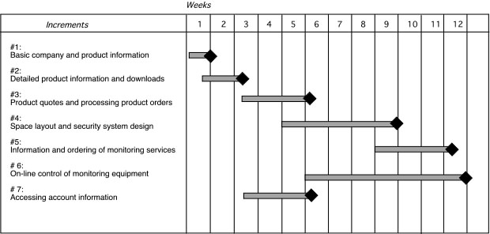
The Schedule

Slide 120
Estimating Time and Effort
Two viable (and quick) approaches to detailed estimation
Usage scenario–based estimation
Examines the usage scenarios for the increment, compares them to previous data on average effort (E_{avg}) for previous increments.
Adjust estimates based on perceived complexity
Product-process table
First column lists, for all major WebE actions, content objects and functions for an increment
Subsequent columns lists estimates of effort (in person-days) required to perform each of the main WebE actions for each content object and function.
Warning! The relationship between effort, people and time is NOT linear.

